Slide 1

INDUSTRIAL TRAINING
Submitted in partial fulfillment of the
Requirements for the award of the degree
Of
Bachelor of Technology
in
Computer Science & Engineering
By:
Gurkirat Singh(32/CSE1/2020)
Department of Computer Science & Engineering
Guru Tegh Bahadur Institute of Technology
Guru Gobind Singh Indraprastha University
Dwarka, New Delhi
Year 2017-2021

Slide 2
ACCIDENT PREVENTION
Duration
7th May, 2020 – 28th June, 2020
By:
Gurkirat Singh(32/CSE1/2020)
At
Coursera, 381 East Evelyn Avenue Mountain View,
CA 94041 United States

Slide 3
Accident Prevention: Drowsiness and Yawn Detector
Prepared by: guided by:
Gurkirat singh Mr. Carlos Guestrin
03213202717 EMILY FOX
cse-1

Slide 4
CONTENTS
Aim
Introduction to Accident Prevention
Requirements
Features of Accident Prevention
Dataset Used
Flow Chart
ER Diagram
Use case diagram
Class Diagram
Technologies used
Concepts used
Steps involved and screenshots
Limitations
References

Slide 5
AIM
Driving while drowsy is a serious and often tragic problem in the United States. A report from the National Highway Traffic Safety Administration estimates that drowsy driving leads to 100,000 police-reported crashes each year, 71,000 injuries and 800 fatalities, and a 125 crore cost. The National Sleep Foundation reported that 37 percent of people admitted to falling asleep behind the wheel. Young adults between the ages of 18–29 are are even more likely to drive when drowsy, with a reported 71 percent compared to approximately half of those in the age range 30 to 64.
A solution to this problem is to identify when a driver is falling asleep, and alarm the driver and passengers of the situation so that appropriate measures can be taken.
In this work we propose two image-based frameworks for the detection and recognition of drowsiness based on a video feed of the driver’s face. Both frameworks are broadly divided into two parts, namely, feature extraction followed by time series based prediction. The two frameworks differ in the way features are extracted and fed into an CNN Network to make predictions. The model aims to monitor a driver’s condition in real-time. From the video, an image-based noninvasive technique is used to detect the facial features of the driver with time and classify drowsiness (Alert or Drowsy) and sound an alarm if drowsy.
The project Accident Prevention includes two features yawn detector and drowsiness detector.

Slide 6
INTRODUCTION TO ACCIDENT PREVENTION
A Accident Prevention is very useful software for preventing Road Accidents. It is divided into two parts:
Yawn Detector
Drowsiness Detector
The increasing number of traffic accidents due to a diminished vigilance level of driver has become a serious problem for society. Accidents related to driver hypovigilance are more serious than other types of accidents, since sleepy drivers often do not take evasive action prior to a collision. Monitoring the driver’s level of vi- gilance and alerting the driver when he is not paying adequate attention to the driving has become matter of concern in order to prevent accidents. The prevention of such accidents is a major focus of effort in the field of active safety research.
Many researchers are working on the development of monitoring systems using specific techniques. The best detection techniques are based on physiological phenomena like brain waves, heart rate, pulse rate and respiration. These techniques are intrusive, causing annoyance. A driver’s state of vigilance can also be characterized by indirect behaviors of the vehicle like lateral position, steering wheel movements.

Slide 7
REQUIREMENTS
2. REQUIREMENT ANALYSIS AND SPECIFICATIONS
2.1. LIBRARIES
Numpy
Scipy
Playsound
Dlib
Imutils
Opencv
2.3. SOFTWARE REQUIREMENTS
Operating System : WINDOWS 7 or above
Python 3.x or above
Command Prompt
2.2. HARDWARE REQUIREMENTS
Webcam
A computer system with atleast i3 or ryzen 3 processor
Minimum 2GB of RAM.

Slide 8
Dataset Used
Dataset
For Drowsiness Detector:
The dataset used for this model is created by us. To create the dataset, we wrote a script that captures eyes from a camera and stores in our local disk. We separated them into their respective labels ‘Open’ or ‘Closed’. The data was manually cleaned by removing the unwanted images which were not necessary for building the model. After training the model on our dataset, we have attached the final weights and model architecture file “models/cnnCat2.h5”.
Now, you can use this model to classify if a person’s eye is open or closed.
For Yawn Detector: shape_predictor_68_face_landmarks.dat
Existing facial databases cover large variations including: different subjects, poses, illumination, occlusions etc. However, the provided annotations appear to have several limitations.
The majority of existing databases provide annotations for a relatively small subset of the overall images.
The accuracy of provided annotations in some cases is not so good (probably due to human fatigue).
The annotation model of each database consists of different number of landmarks.
These problems make cross-database experiments and comparisons between different methods almost infeasible. To overcome these difficulties, we propose a semi-automatic annotation methodology for annotating massive face datasets. This is the first attempt to create a tool suitable for annotating massive facial databases

Slide 9
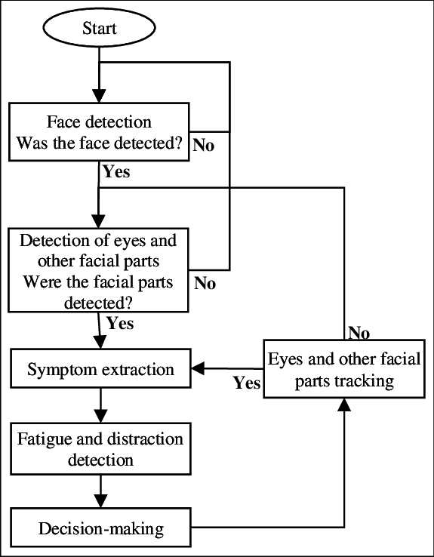
Flow Chart

Slide 10
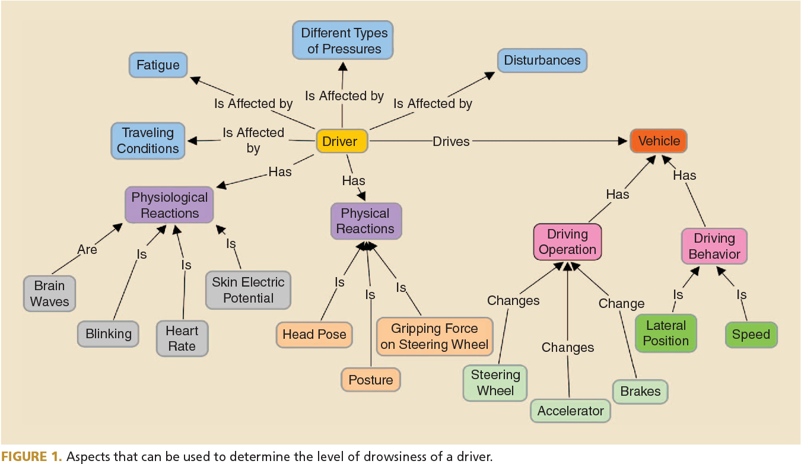
ER DIAGRAM

Slide 11
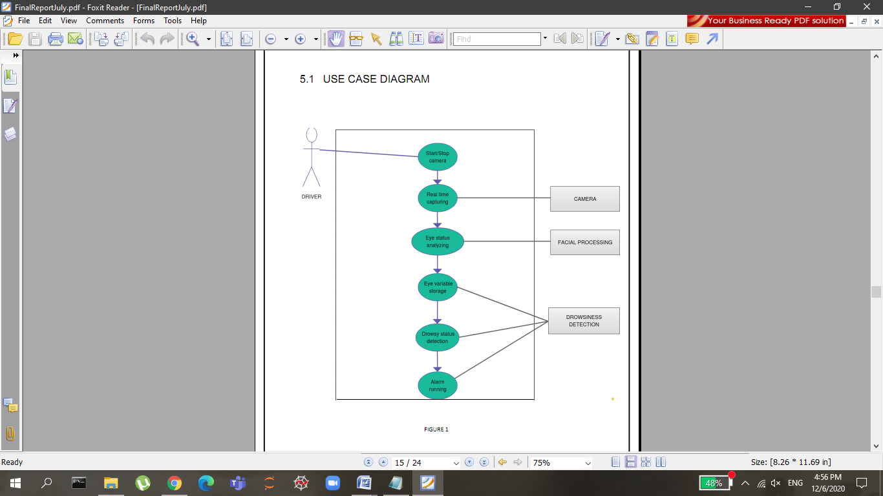
Use Case Diagram

Slide 12
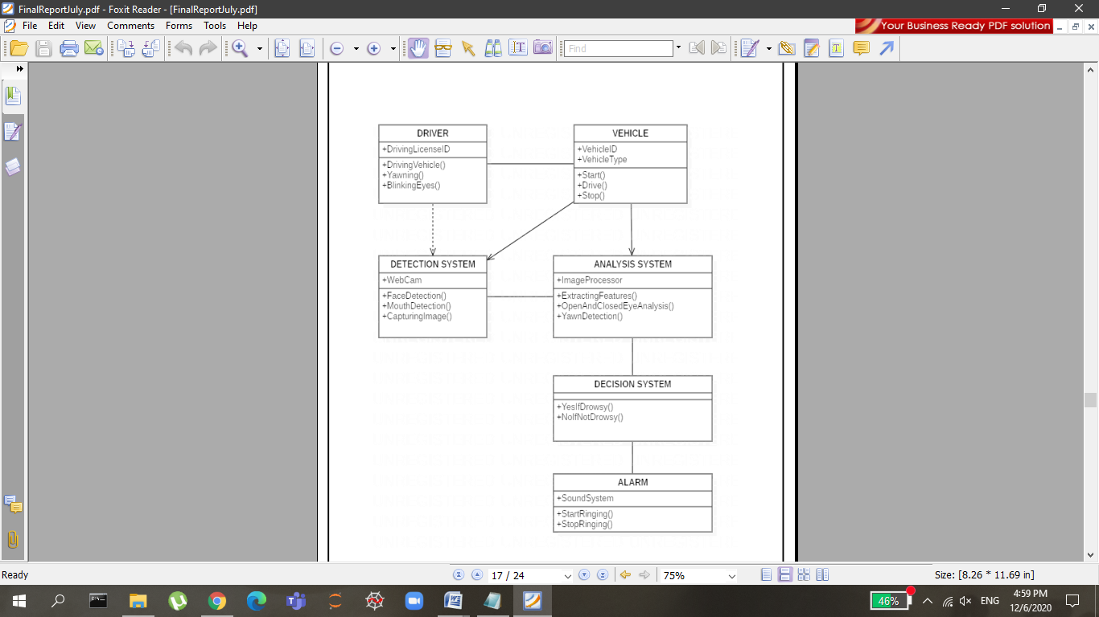
Class Diagram

Slide 13
TECHNOLOGIES USED
1. PYTHON:
The main technology used in the project is PYTHON. The Python language has diversified application in the software development companies
Some important features of Java are as follows : Simple, Extensive Support Libraries, Less lines of Code, Large Community, Integration Feature
2. SPYDER:
Spyder notebooks have seen enthusiastic adoption in the data science community, to an extent where they are increasingly replacing Microsoft Word as the default authoring environment for research.
3. IMAGE PROCESSING:
In computer science, digital image processing is the use of computer algorithms to perform image processing on digital images.
In our program we used Dlib, a pre-trained program trained on the HELEN dataset to detect human faces using the pre-defined 68 landmarks.
After passing our video feed to the dlib frame by frame, we are able to detect left eye and right eye features of the face.
Now, we drew contours around it using OpenCV.

Slide 14
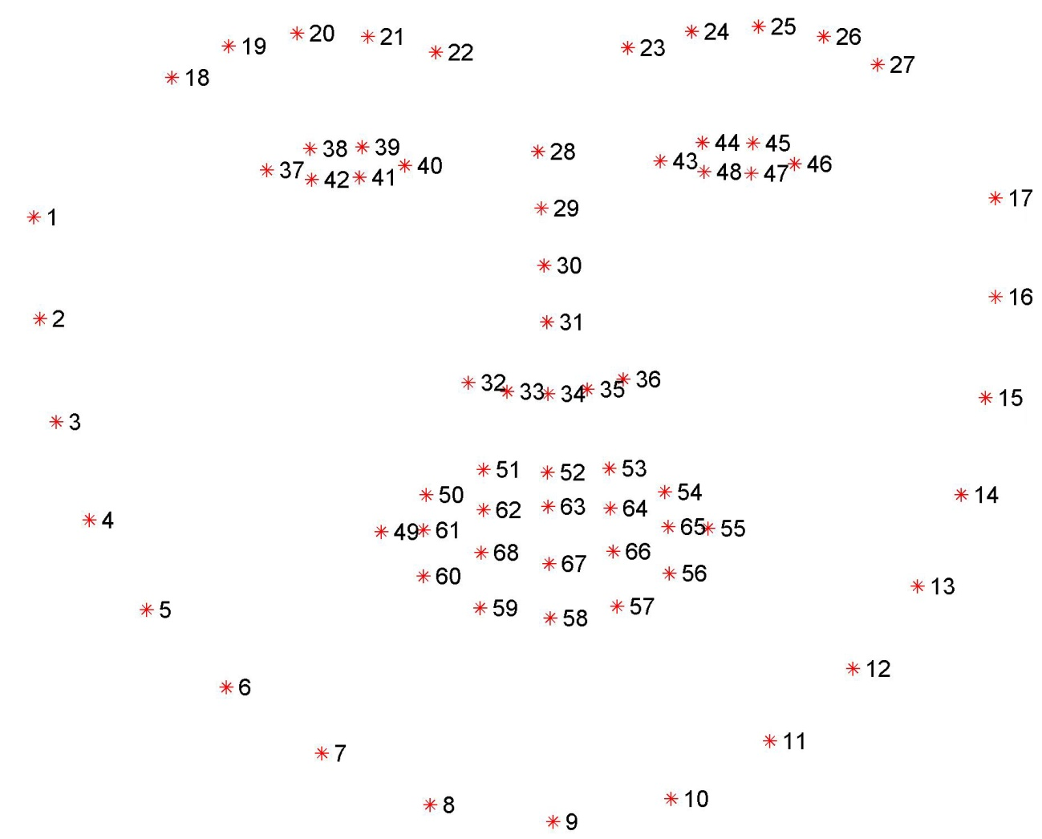
Concepts used
Numpy: Pre-requisite for Dlib
Scipy: Used for calculating Euclidean distance between the eyelids.
Playsound: Used for sounding the alarm
Dlib: This program is used to find the frontal human face and estimate its pose using 68 face landmarks.
Imutils: Convenient functions written for Opencv.
Opencv: Used to get the video stream from the webcam, etc.

Slide 15
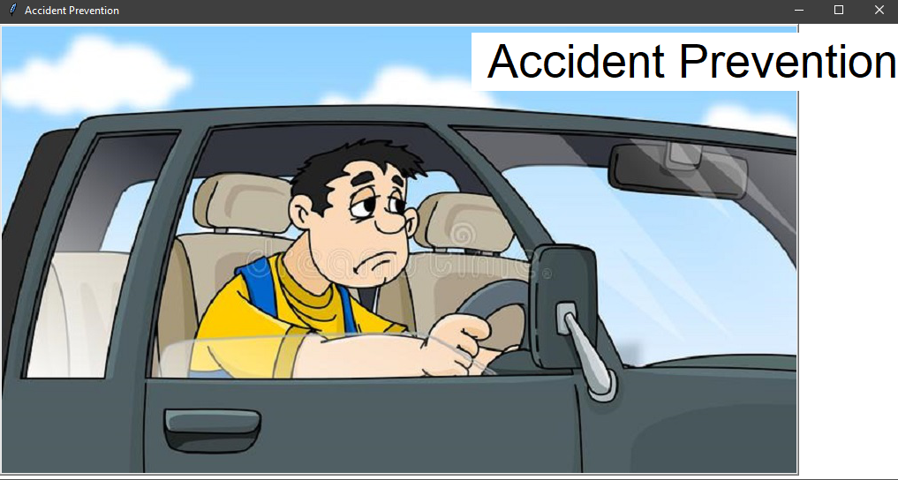
1.Welcome Page

Slide 16
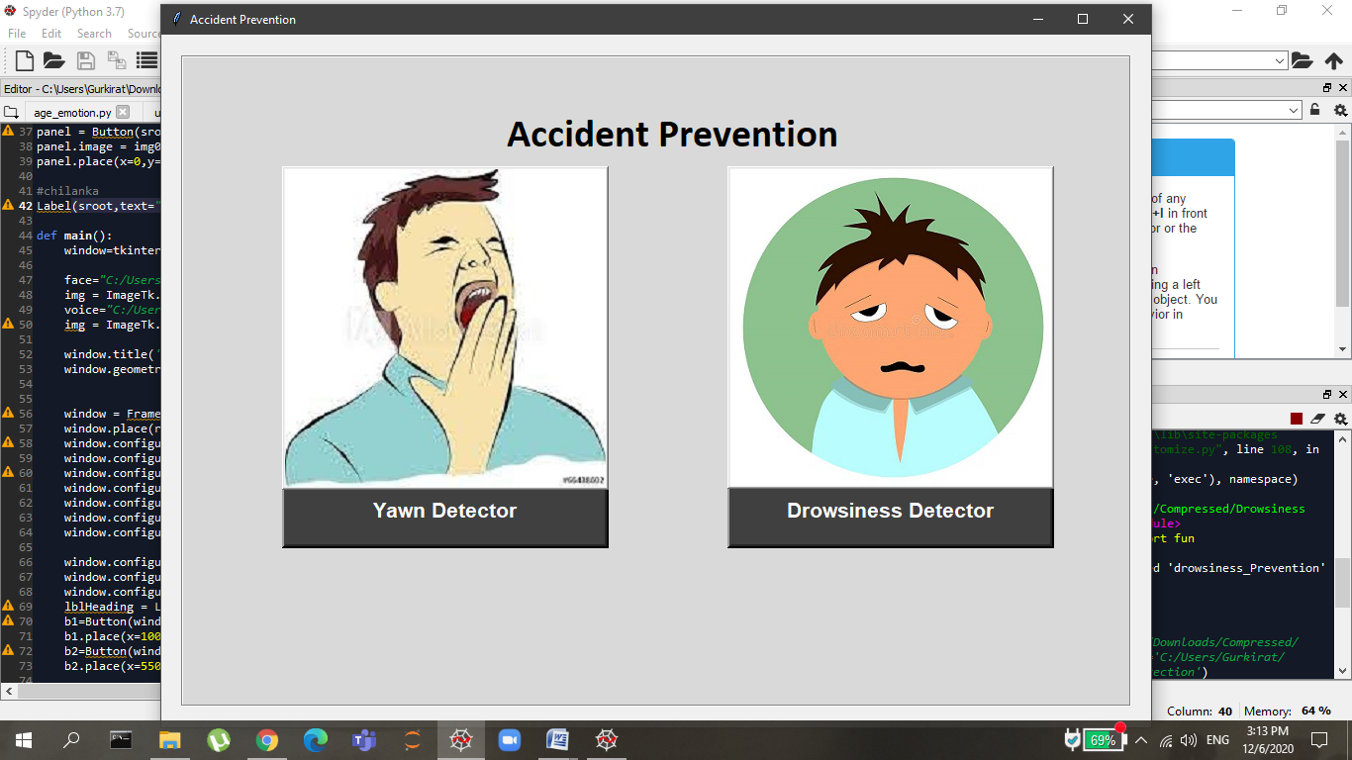

Slide 17
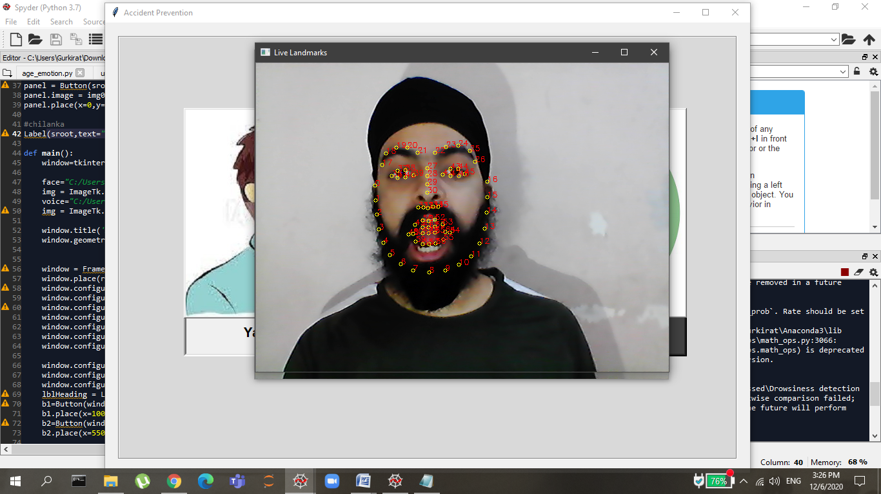
Facial Landmarks for Yawn Detector

Slide 18
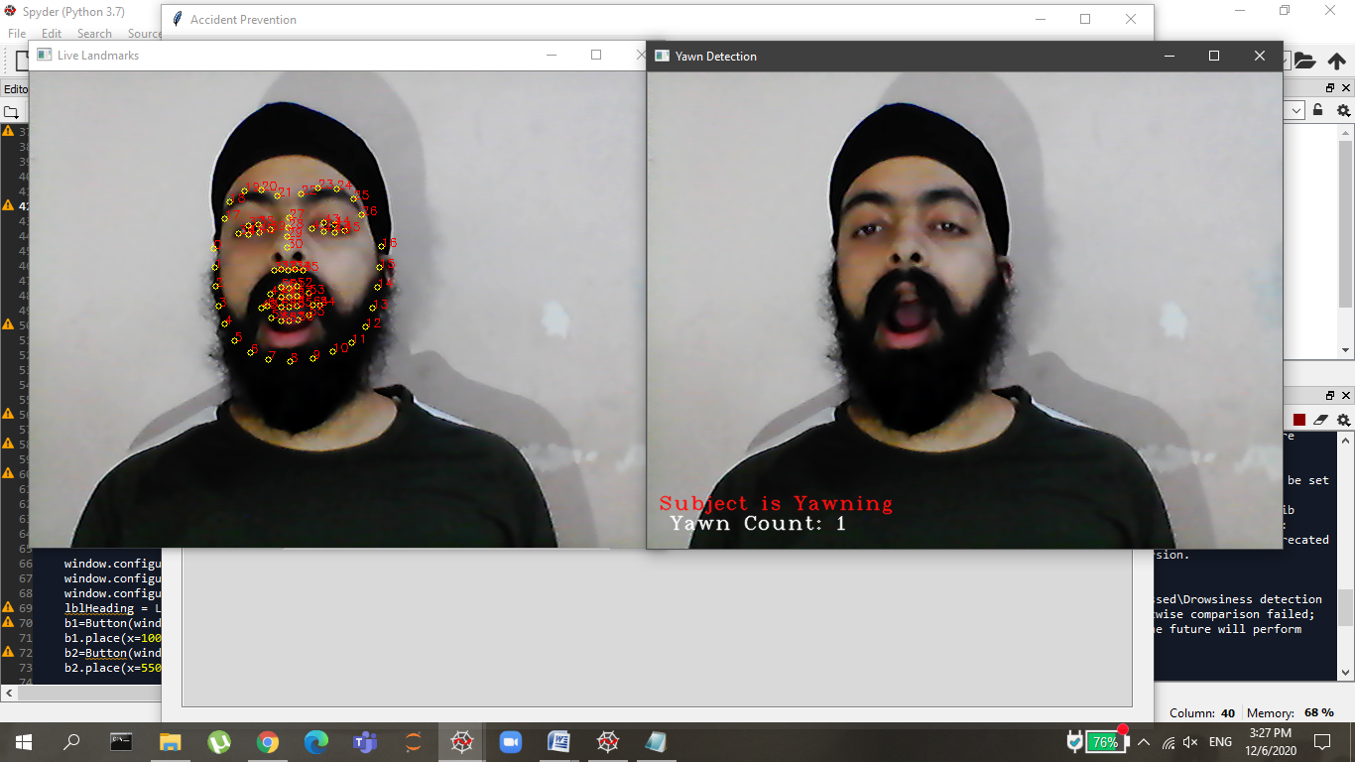
Yawn Count is 1 after detecting lips wide open

Slide 19
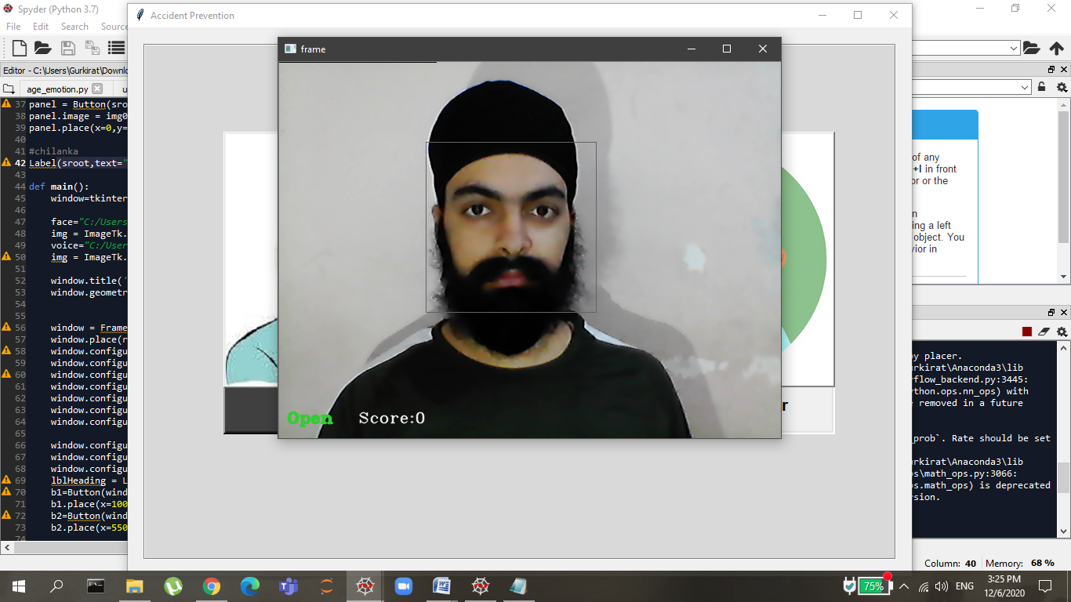
Drowsiness Detector: When Eyes are Open No Alarm Raised

Slide 20
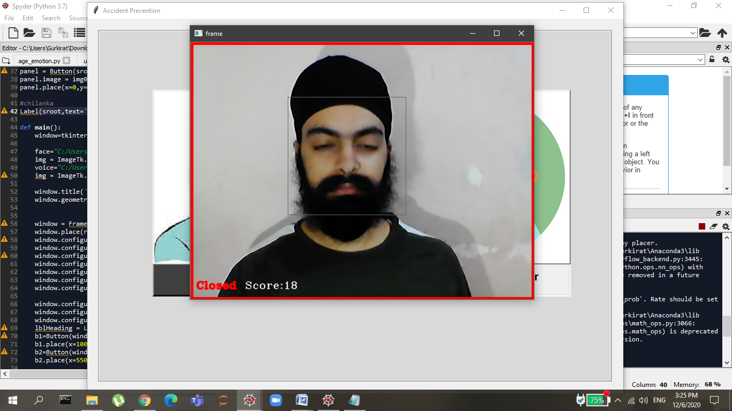
After Closing Eyes for more than 15 seconds an alarm will get Raised

Slide 21
LIMITATIONS OF THE PROJECT
GUI is only in English.
Yawn Detection and Drowsiness Detection cannot be executed together.
The vehicle type, driver experience, geometric characteristics and state of the road can sometimes produce interference.

Slide 22
REFERENCES
Z. Zhang and J. Zhang, “A new real-time eye tracking for driver fatigue detection,” in Proceedings of the IEEE 6th International Conference on ITS Telecommunications, pp. 8–11, June 2006.
R. Parsai and P. Bajaj, “Intelligent monitoring system for driver's alertness (a vision based approach),” in Knowledge-Based Intelligent Information and Engineering Systems, vol. 4692 of Lecture Notes in Computer Science, pp. 471–477, Springer, Berlin
M. Eriksson and N. P. Papanikolopoulos, “Eye-tracking for detection of driver fatigue,” in Proceedings of the IEEE Conference on Intelligent Transportation Systems (ITSC '97), pp. 314–319, 1997.
S. M. Shi, L. S. Jin, R. B. Wang, and B. L. Tong, “Driver mouth monitoring method based on machine vision,” Journal of JiLin University, vol. 34, no. 2, pp. 232–236, 2004.
W. Wang, J. Xi, and H. Chen, “Modeling and recognizing driver behavior based on driving data: a survey,” Mathematical Problems in Engineering, vol. 2014, Article ID 245641, 20 pages, 2014.View at: |
Q. Tan, M. Yang, T. Luo et al., “A novel interdigital capacitor pressure sensor based on LTCC technology,” Journal of Sensors, vol. 2014, Article ID 431503, 6 pages, 2014.
Y. Freund and R. E. Schapire, “A desicion-theoretic generalization of on-line learning and an application to boosting,” in Computational Learning Theory, vol. 904 of Lecture Notes in Computer Science, pp. 23–37, Springer, Berlin, Germany
P. Viola and M. J. Jones, “Robust real-time object detection,” International Journal of Computer Vision, vol. 57, no. 2, pp. 137–154, 2004.
D. F. Dinges and R. Grace, PERCLOS: A Valid Psychophysiological Mesure of Alertness As Assessed by Psychomotor Vigilance, Federal Highway Administration, Office of Motor Carriers, 1998.
W. Kong, Z. Zhou, L. Zhou, Y. Dai, G. Borghini, and F. Babiloni, “Estimation for driver fatigue with phase locking value,” International Journal of Bioelectromagnetism, vol. 14, no. 3, pp. 115–120, 2012.View at:

Slide 23
Thank you

